Slide 1
Pharmacy Management System

Slide 2
Group Members
2018CS402
2018CS418
2018CS420

Slide 3
Objectives
replace manual based system
Reduce Human Error
Handles all section.
Data Saving & Manipulating
Reduce burden
Notes:
Root cause is to mini human effort. In manual based work, pharmacy stores have to work very hard to maintain all record and functionalities. Also they have to hire more people for their work convenience. But that is not the permanent solution. As soon as your business grow, complexity increases..
Also there is a lot of chances of human errors at manual based work. That’s why we need computer based management system for that.
This system will handle all the operation that is going on any pharmacy stores e.g. billing, stock record etc.
As we all know maintaining data manually is quite cumber and also searching from that data is more difficult, that’s why we are making this system that store and manipulate data effectively….
AS there are lots of difficulties in manual based work, so it increases the burden on store managers. This system will decrease the burden on managers.
*The pharmacy management system is built in order to replace manual based system to computerize. Here, system is expected to be efficient, useful and affordable on implementing tasks that is order by the pharmacy manager.
The main Objectives of the PMS is making the pharmacy organizations computerized by creating neat work through minimizing or eliminating wasting of time as well as removing the resources such as papers for data saving since know a days is paper based, decrease malfunctioned works on the medical usage by giving correct information on each medicine.

Slide 4
Requirement Phase
1

Slide 5
Requirement Definition-Readers
System Customer
End-Users
Managers
System Engineers
Test Engineers
Maintenance Engineers
Notes:
The first process of every project is to analyze the requirements and then define those requirements. But first we need to define the readers of the project.
System Customers :
Specify the requirements and read them to check that they meet their needs. Customers specify changes to the requirements.
End-users :
Use this SRD to learn about how to use pharmacy management software more effectively.
Managers :
Use the requirements document to plan a bid for the system and to plan the system development process.
System Engineers :
Use the requirements to understand what system is to be developed.
System Test Engineers :
Use the requirements to develop validation tests for the system.
System Maintenance Engineers :
Use the requirements to understand the system and the relationships between its parts.

Slide 6
Functional Requirements
medicine stock.
Supplier Info
Authentication
Searching
Billing
Bill Record
Add, Delete, Edit record
Language
Notes:
Statements of services the system should provide, how the system should react to particular inputs and how the system should behave in particular situations.
May state what the system should not do.
Login required:
If you want to access to the inner content of the app, you have to login to the app otherwise you are not allowed to do anything with the application.
Medicine Stock:
This will store details and record of each medicine in the stock. It will store the quantity, formula and company name of that medicine. This system allows you to add, remove and update any stock in the list.
Billing :
This pharmacy management system has an ability to deal with the customer needs. In billing section, we can search any type of medicine and can load it in the billing section. We should also have to mention the quantity of that medicine. If medicine quantity is less than it will show you an error message. Billing section can load multiple medicine in the billing list. After the finalization of the bill, directs the bill for printing.
Employees :
This section will hold all the details about the current working employees e.g. Name, Salary, Duty time, address etc. You can add, update, and remove any employees from the list.
Companies :
In this system, we have also store all the companies that we are dealing with. We hold all companies data such as Company Name, Medicines, Contract etc. we can also add, remove and update any type company data.

Slide 7
Non-Functional Requirements
Response time
User Interface.
Core 2 duo or above system required.
Printer Required for invoice.
Notes:
Constraints on the services or functions offered by the system such as timing constraints, constraints on the development process, standards, etc.
Often apply to the system as a whole rather than individual features or services.
Navigation timing
Click button Response

Slide 8
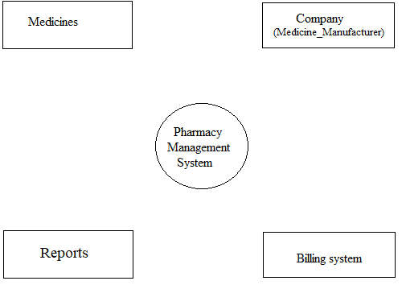
High Level Overview
Medicine Record
Suppliers Info
Reports
Billing System

Slide 9
Water Fall Model
Why Water Fall for this project? https://linktr.ee/rachnaPharmacy
Notes:
Now we have determined all our requirements, So in our case waterfall is best.
Why Waterfall?
Long duration
Requirements well defined

Slide 10
Design Phase
2

Slide 11
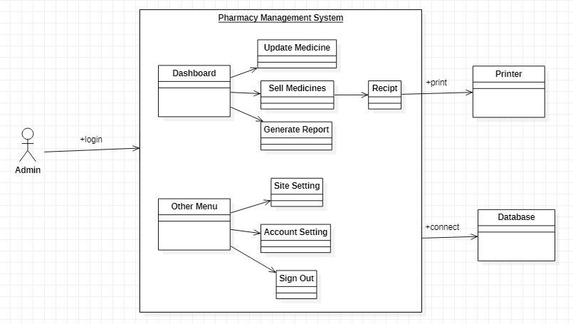
Architecture Diagram

Slide 12
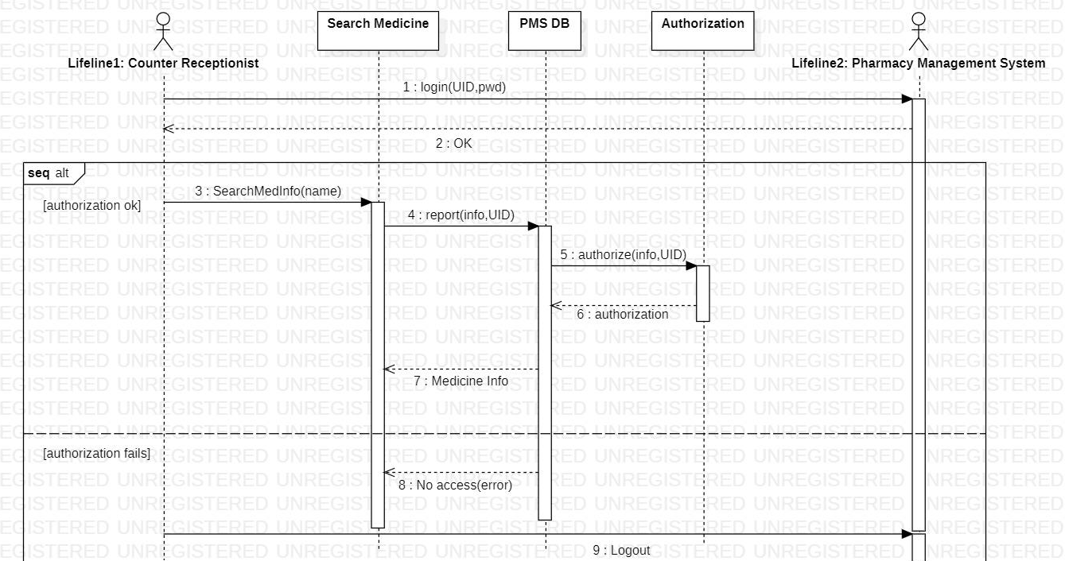
Sequence Diagram – Search Medicine

Slide 13
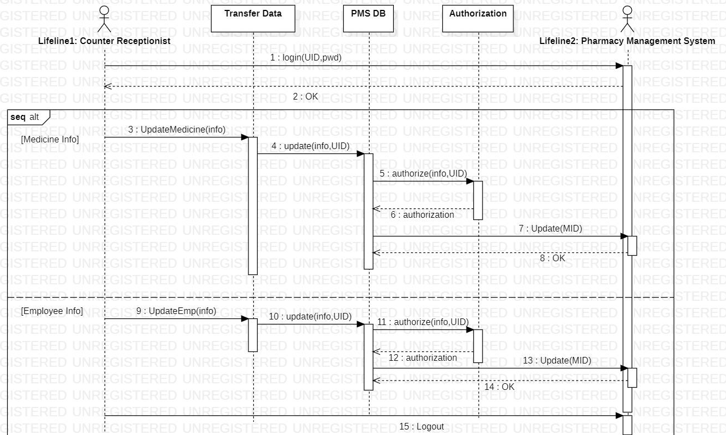
Sequence Diagram – Transfer Data

Slide 14
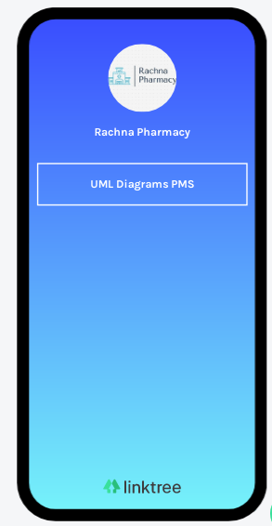
Learn More...
Link :
linktr.ee/rachnaPharmacy

Slide 15
Implementation Phase
3

Slide 16
Implementation
Tools
Xamp Server
Sublime Text Editor
Plateform Supported
Chrome
Opera
Firefox

Slide 17
Languages
Front End
HTML
CSS
BootStrap
JavaScript
Back End
PHP
Database : mysql

Slide 18
Pages
Login
Home
Inventeries
Add new medicines
Reports
Site Setting
User Profile

Slide 19
Pages Description
Sr | Screen name | Description
1 | Login | Allows admin to login PMS
2 | Home | Display Medicine Categories
3 | Inventeries | Display all medicine including their name, quantity & company
4 | Add new medicine | Add new medicine in database
5 | Reports | Display reports of sold medicine including customer name and sold date
6 | Site Setting | Display/ Change site title and name
7 | Profile/ Account Setting | Display/ Change admin info

Slide 20
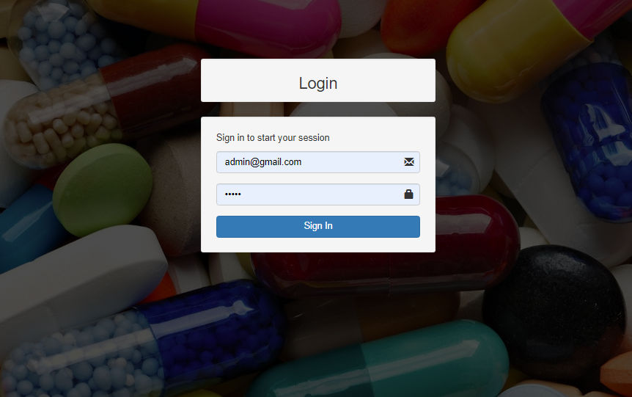
User Interface
Place your screenshot here
Easy to use
Secure & Fast
User Friendly

Slide 21
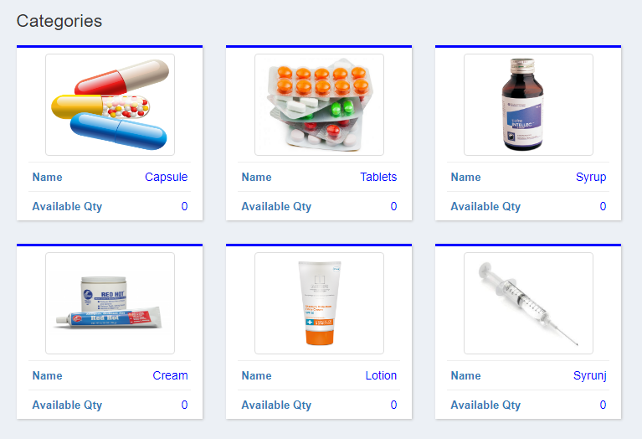
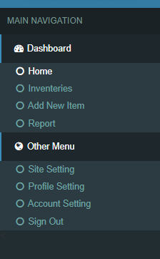
Home Page

Slide 22
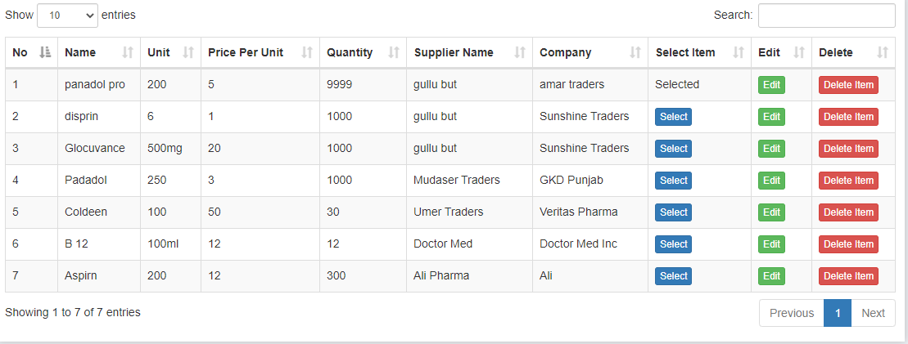
Inventories

Slide 23
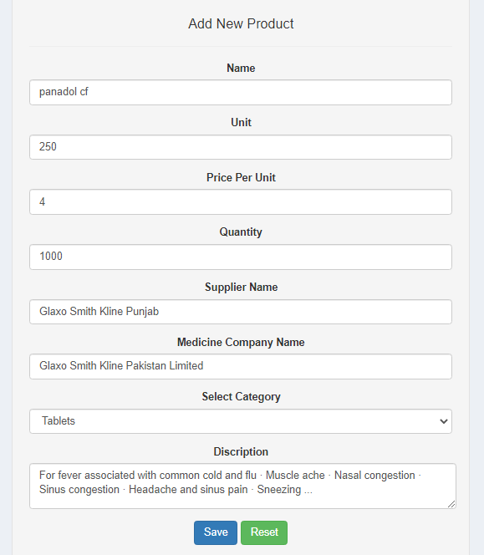
Add Medicine Page

Slide 24
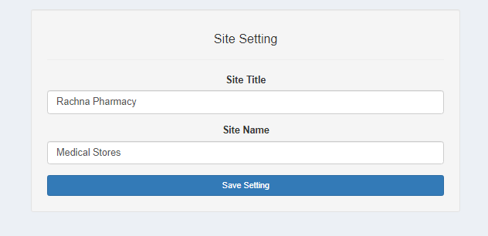
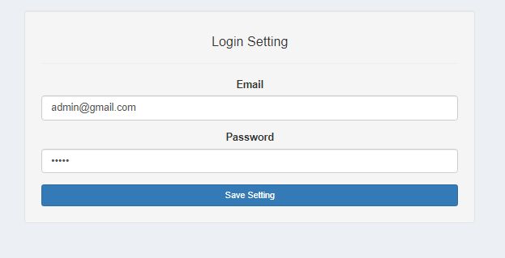
Setting Pages

Slide 25
Testing Phase
4

Slide 26
Testing
Two type of testing
Unit Testing
Integrating testing/system testing

Slide 27
Unit Testing
Individual testing of the functions.
In which we test all the components or functons one by one whether it is working fine.

Slide 28
Test Cases
Effective way to test the functions.
The test cases should show that, when used as expected, the component that you are testing does what it is supposed to do.
If there are defects in the component, these should be revealed by test cases.
Choose inputs that force the system to generate all error messages.
Force invalid outputs to be generated;

Slide 29
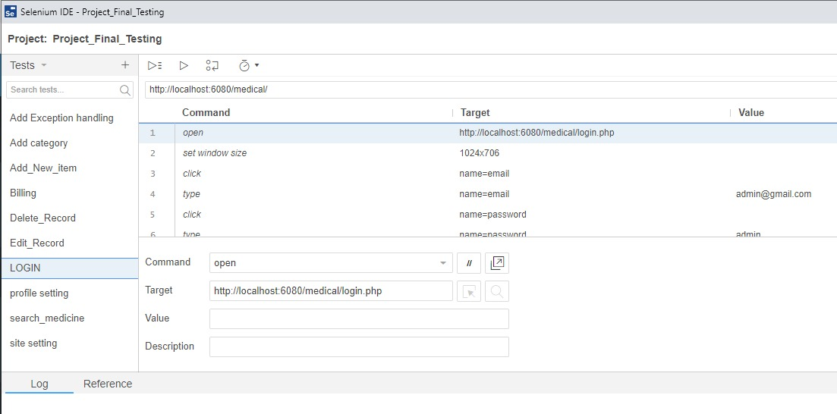
Selenium Tool

Slide 30
Integrating testing/system testing
System testing checks that components are compatible, interact correctly and transfer the right data at the right time across their interfaces.
All system functions that are accessed through menus should be tested.
Combinations of functions (e.g., text formatting) that are accessed through the same menu must be tested.
Where user input is provided, all functions must be tested with both correct and incorrect input.

Slide 31
Why testing?
To Validate the all the modules.
To validate the requirements.
To test the software it is doing the right job.

Slide 32
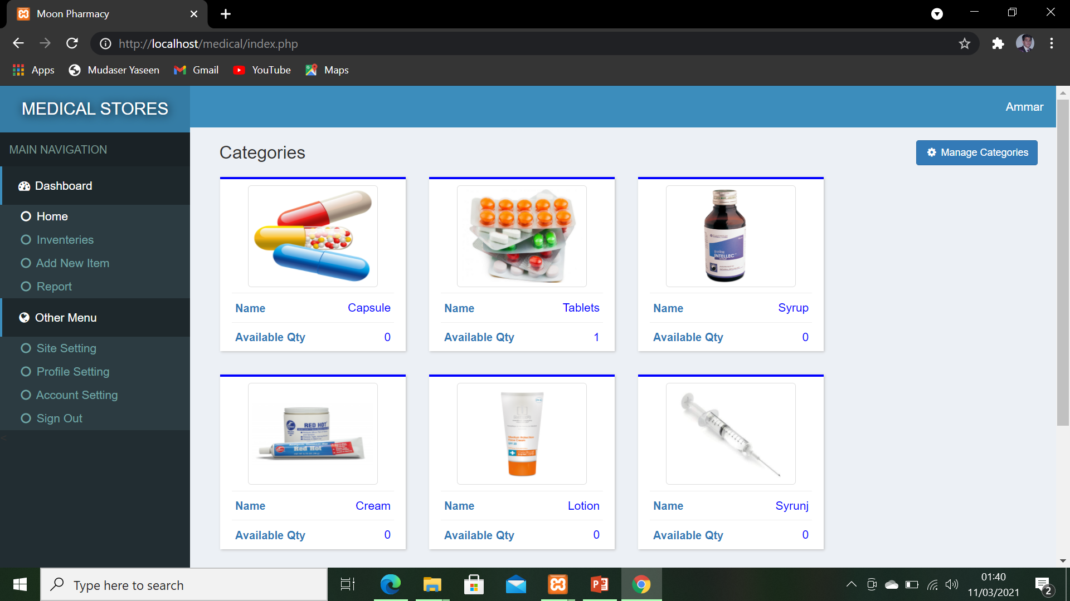
PMS

Slide 33
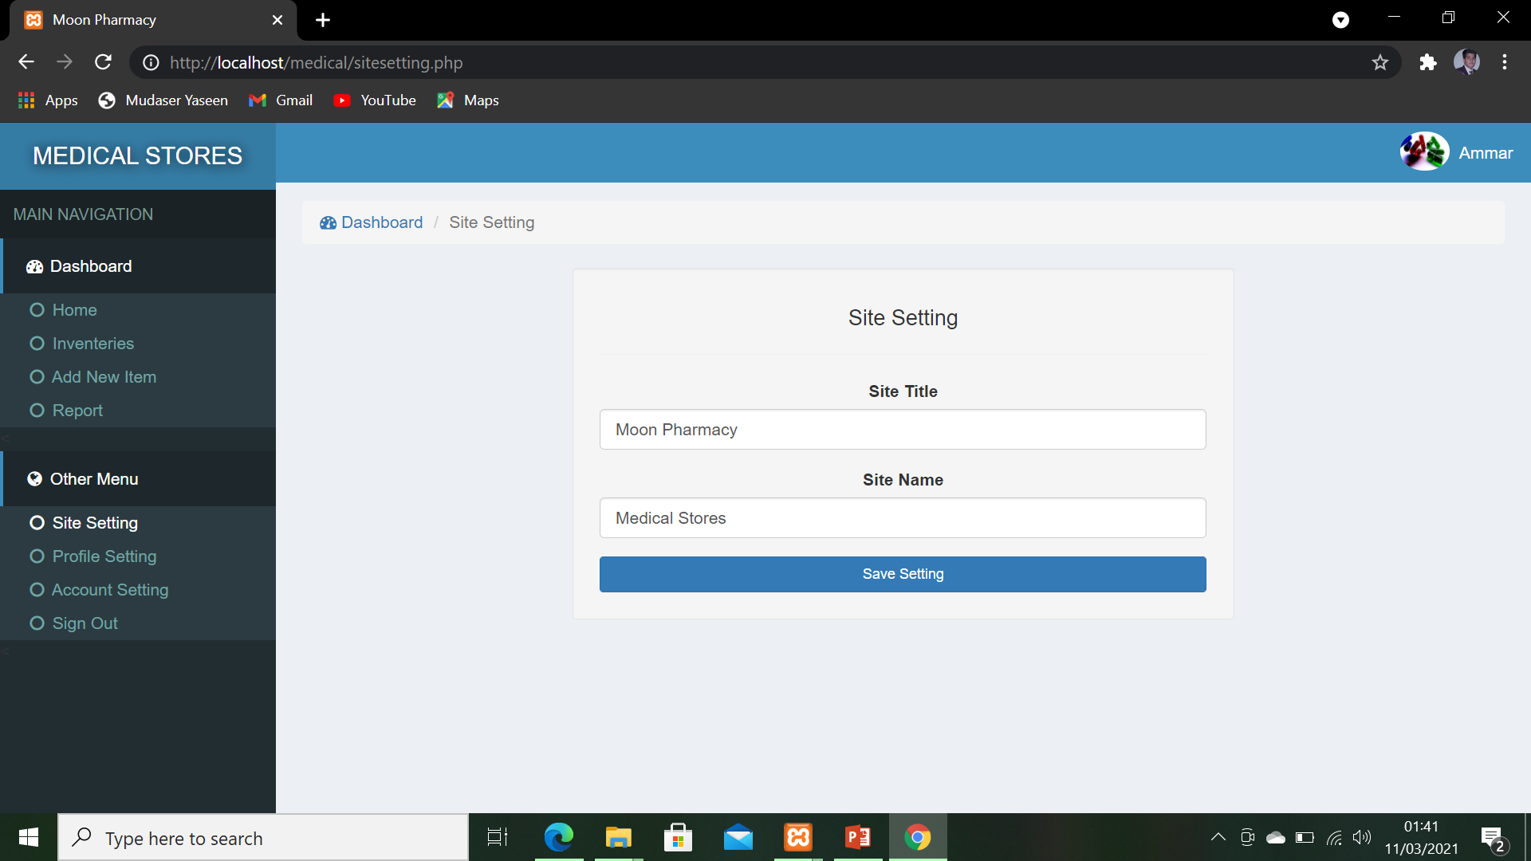
PMS

Slide 34
Database

Slide 35
Tables
User
Inventeries
Categories
Sold
Site

Slide 36
THE END

